Slide 1
Basics of Machine Learning
A high-level view

Slide 2
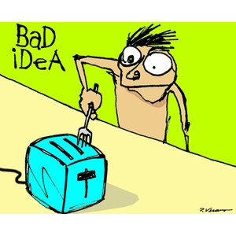
How do we learn?
Intensely simplified:
We have an idea or make a decision.
Examples, “2 + 2 =4”, “2 + 2 = 5”, “I should study for the exam”, “I should stick my finger in the light socket”
These ideas are reinforced each time we have them.
If these ideas and decisions have positive results we are more likely to repeat them, further reinforcing them.
Anything you do regularly is “taught” to be true, or a good idea.
Overtime, all ideas are negatively reinforced, mildly reducing your chance of making that decision in the future.

Slide 3
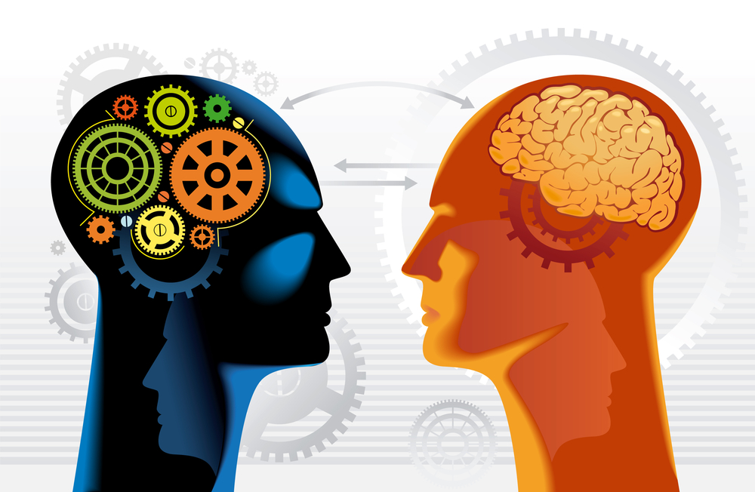
Machine Learning Algorithms
Many machine learning algorithms will take a similar approach:
Take your current best guess.
Evaluate the quality of your current best guess.
Adjust your best guess in a manner that hopefully improves its quality. Then start the process over again.

Slide 4
Machine Learning
We will use known data to train our machine learning algorithms. This known data is often referred to as our features.
For some problems, our features will be associated with known correct answers, referred to as labels.
Example:
Feature – [size of house, number of rooms, location] <- One feature
Features – A collection of multiple instances of the data feature
Labels – How much did this house sell for
With this data we could train an algorithm to predict the price a house would sell for
When we have labels for our data we call this Supervised Learning

Slide 5
Supervised Learning
In supervised learning problems, we can evaluate our current best guess by comparing it to the labels in our training data.
Supervised Learning can be broken down into two main categories:
Regression – Regression problems attempt to map input values to a continuous output. Predicting the price a house would sell for based on its features is an example of a regression problem.
Classification – Classification problems attempt to predict discrete output results. Examples would include using data to predict any of the following, “will a particular student graduate?”, “is a tumor benign?”, “is this a picture of a cat, dog or a flower?”

Slide 6

Unsupervised Learning
In unsupervised learning, our data is not labeled with correct results. Instead our goal is to derive structure from the data.
The most common type of unsupervised learning is called clustering.
Clustering attempts to organize the given data into groups based on the most decisive relationships found in the data.
An example would be to organize a collections of fruits based on shared characteristics such as color, size and shape.

